Slide 1
Data warehousing /Data mining for Z-Tak
Ivy Consulting

Slide 2
Data warehousing
A repository of integrated information, available for queries and analysis.
Data and information are extracted from heterogeneous sources as they are generated.
This makes it much easier and more efficient to run queries over data that originally came from different sources.
When used properly data warehouses can increase profits by 400%
Data warehouses can have CRM applications which help create better customer relationships and increase profits.
Data warehouses are Decision Support Systems that help make executive decisions easier.
Business Intelligence systems that provide better reports for Decision support, forecasting and Client Relationship.

Slide 3
Data mining
Data Mining is the process of analyzing large data sets in order to find patterns that can help to isolate key variables to build predictive models for management decision making.
Best alternative to traditional methods of data analysis on large sets of data.
May offer a profound impact on current practices in manufacturing
Uses nuggets which is a robust well tested technology employing Artificial Intelligence methods to uncover useful and hidden patterns in data.
Transforming data into knowledge
Data Mining is for executives involved in strategic and tactical decision making as well as operating managers responsible for cost reduction.
Strategic Managers use data mining for competitive intelligence, identifying market opportunities, product launch decisions and product positioning.

Slide 4
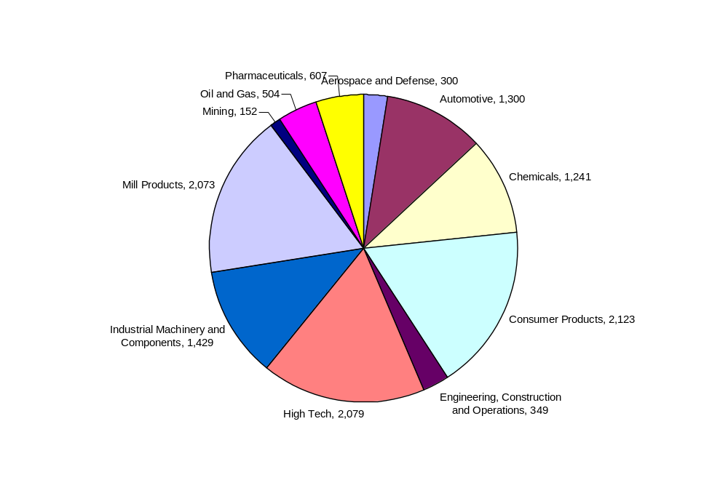
Companies using Data Warehousing/Data Mining
    Aerospace and Defense
    Automotive
    Chemicals
    Consumer Products
    Engineering, Construction and Operations
    High Tech
    Industrial Machinery and Components
    Mill Products
    Mining
    Oil and Gas
    Pharmaceuticals

Slide 5
How they are using them
Coordinate operations with partners and suppliers
Detect and resolve exceptions and performance deviation in real time and at low cost
Institutionalize Lean and Six Sigma processes and monitor production to drive continuous improvement
Comply with environmental, health, and safety standards
Improve employee productivity and create a high-quality work environment

Slide 6
What are they doing with them?
Forecasting Sales
Optimizing inventory levels for lower Cash Flow Cycle Times
Hooking up CRM solutions with data warehouse for better and improved customer service.
Integrate the entire business with global supply chains and partner networks
Link full range of business processes starting from design, planning and procurement to manufacturing, sales, distribution and customer service
Streamline the enterprise boost after-sales and sustain product leadership

Slide 7
How should the data be stored so that it can be efficiently sorted?
Turning away from large-scale data warehousing and focusing more on results
Stored in Partitioned databases by module enabling faster and efficient querying
Real time data querying by refreshing the data warehouse periodically on a regular basis

Slide 8
Vendor Evaluation
Technology and Product services in Data warehousing
SAP Manufacturing
Oracle E-Business Suite Manufacturing
ERP
Technology and Product services in Data mining
Business Objects
Informatica
Cognos
Hyperion
IBM
Teradata
SAS
SPSS
Hummingbird
The most popular products are Informatica , Cognos, Teradata.

Slide 9
Vendor Evaluation for Data warehousing (contd)
Attribute | SAP | ORACLE E buisness manufacturing
size and financial status | World's largest business software company,employs more than 39,300 people in more than 50 countries, and serves more than 43,400 customers worldwide. Software and software related service revenues for the 2007 third quarter were €1.74 billion (2006: €1.54 billion1), which is an increase of 13% (16% at constant currencies2) compared to the third quarter of 2006. Operating income for the third quarter of 2007 was €601 million (2006: €549 million), which was an increase of 9% compared to the third quarter of 2006. | one of the major companies developing database management systems (DBMS), tools for database development, middle-tier software, enterprise resource planning software (ERP), customer relationship management software (CRM) and supply chain management (SCM) software. Oracle was founded in 1977, and has offices in more than 145 countries around the world. As of 2005, it employed more than 50,000 people worldwide. New software licensing revenue grew 35 percent to US$1.1 billion, the strongest growth of any quarter in the past decade. Revenue for the period ending August 31 was up 26 percent to US$4.5 billion and net income grew by 25 percent to $840 million compared to the same quarter last year, based on generally accepted accounting principles (GAAP).
Support Capabilities | Variety of Service packages and solutions. SAP Active Global Support End-to-end solution operations – Optimizes the way you operate and support your SAP solutions SAP MaxAttention ,SAP Safeguarding ,SAP Premium Support,SAP Standard Support | Variety of Service Packages Available Premier Support ,Advanced Customer Services Lifetime Support ,Proactive Automated Support Configuration Support Manager ,Unbreakable Linux

Slide 10
Vendor Evaluation for Data warehousing (contd)
Attribute | SAP | Oracle E business manufacturing
Consulting | SAP consulting - Managing complexity, mitigating risks, and controlling costs of today's solutions has become increasingly important when considering your IT strategy. The optimization of your operations and solution landscape is key to becoming a best-run business. SAP Active Global Support delivers the skills and resources you need to optimize the performance of your solution and manage you business processes more effectively. | Technology Consulting Upgrade Services Partner Services Applications Consulting Oracle Consulting is one of the world's largest consulting organizations, with more than 11,000 consulting professionals supporting Oracle customers and partners in more than 145 countries Get direct access to Oracle Global Product Development and Oracle's award-winning support services Combine on-site and remote resources to match the expertise, solution, and cost for your consulting engagement Help you assess your business needs Create your enterprise computing strategy Deploy new technology to maximize the value of your Oracle investment

Slide 11
Vendor Evaluation for Data warehousing Features
SAP | Oracle E Business manufacturing
Manufacturing planning – Optimally plan, schedule, and sequence factory-floor production to produce and deliver promised orders. Manufacturing execution – Deliver on production plans by managing production processes, staff deployment, and other factory-floor resources. Document, monitor, and dispatch inventory during the entire production life cycle. Quality management – Monitor and document compliance with quality standards. Maintenance management – Plan, schedule, and sequence maintenance to optimize assets and minimize downtime. Environment, health, and safety management – Handle product safety, dangerous goods and their disposal, waste and emissions, industrial hygiene, and occupational health and safety. | Oracle® Manufacturing Execution System (MES) for Process Manufacturing is an add-on application to Oracle Process Manufacturing that provides intensive, multifaceted shop floor execution capabilities. Process-Driven Operator Workbench Processes can be grouped as reusable procedures. Dispensing The management of the ingredient dispensing (also known as preweigh) process to control the measurement, containerization and labeling of precise quantities. Nonconformance Management Even in the most controlled production environments, unexpected events can happen that may have direct impact on the manufacturing process and the quality of final product. Electronic Master and Control Batch Record Most manufacturing industries keep detailed paper records of their manufacturing records.

Slide 12
Vendor Evaluation for Data Mining.
Attribute | Cognos | Informatica | Teradata
size and financial status | 4,051.55 mil market cap, 1.41 TTM $, sales 12.26 TTM$ 3,507 employees | $324.6 Million in year 2006 Employees 1200 + Customers 1900+ | 2006 Revenue$4.6 billion Net Income$151 million number of Employees***21,000
Support Capabilities | Knowledge base Documentation Product information Proven practices Product downloads Support guide Diagnostic tools Case Management | Well engineered, comprehensive set of support programs tailored to fit your needs . Consistent and reliable support processes that you can expect every time and in each location Rapid turnaround on critical issues and delivery of fixes to ensure your project is on time, every time | IT management services. Maintenance and support services. Managed services Deployment services E commerce services.
Consulting | Solution planning services, Solution implementation services, Business improvement services. | Consultants provided for data integration and support. Lead the entire Decision support project or guidance through out the project. | Consultants available for RFID, Decision Modeling, Operational store consulting, User impact consulting, Business modeling consulting ,Accessibility consulting.

Slide 13
Vendor Evaluation for Data Mining Features
Cognos | Informatica
Leverage their existing investments by aggregating data from transaction systems (SAP, Oracle, Manugistics, etc.) and other sources across the organization, creating a single, integrated performance management framework – for rapid decision-making | Operational Efficiency Manufacturers are under constant pressure to reduce operating costs. A growing global economy necessitates better inventory control throughout the supply chain, while stiff competition compels manufacturers to globally outsource to deliver products at lower costs. Initiatives to streamline
Analyze customer, product, market, and channel profitability | manufacturing processes, such as capturing real-time demand signals, radio frequency
Move beyond cumbersome, error-prone spreadsheets for key plans like sales and operations planning (S&OP) with flexible, connected software to reconcile sales and demand forecasts with supply chain and production plans, and to test multiple cost scenarios | Enhance compliance reporting capabilities through access to clean, documented dats instead of keeping data in error prone spread sheets.
Identify the source of production issues and take corrective action.
Comply with SOX, EPA , OSHA etc. | Regulatory Compliance OSHA,, SOX, EPA

Slide 14
What is needed to begin Data Warehousing?
Determine appetite for change
Identify the most likely business unit to benefit from a data warehouse and approach it proactively
Determine data access controls
Assemble the team
Decide on the implementation approach
Identify the project scope
Establish the success criteria
Conduct the "25 question" analysis
Assess current data quality and pre-cleansing efforts
Don't forget the metadata

Slide 15
How much data is needed for Data Mining to be useful?
Companies are beginning to step away from huge volumes of data trying to avoid Analysis Paralysis and concentrating on small volumes of data and increasing efficiency by using Statistical probability methods.
Specific sets of data required for the modules the company would like to develop would be a great start .

Slide 16
Implementation Techniques
Analysis
Design
Deployment
Production support
Detailed steps
Data Analysis – Gathering information from legacy systems.
Cleansing and Scrubbing of the data has to be done through ETL tools (Extraction, Transformation and Loading) – Data Migration
Data mining and Metadata determination
Determine modules/Data marts
Different module examples are operations module, manufacturing module, reporting module, CRM module.
Deployment on module basis or a data mart basis.
OLAP and OLTP technique inclusion

Slide 17
Recommendations

Slide 18
Glossary
Data marts - Repository of data gathered from operational data and other sources that is designed to serve a particular community of knowledge workers.
Metadata – Data about data
ETL – Extraction, Transformation, Loading
OLAP – Online Analytical Processing
OLTP – Online Transaction Processing
Nuggets - robust well tested technology employing Artificial Intelligence methods to uncover hidden patterns in data

